Slide 1
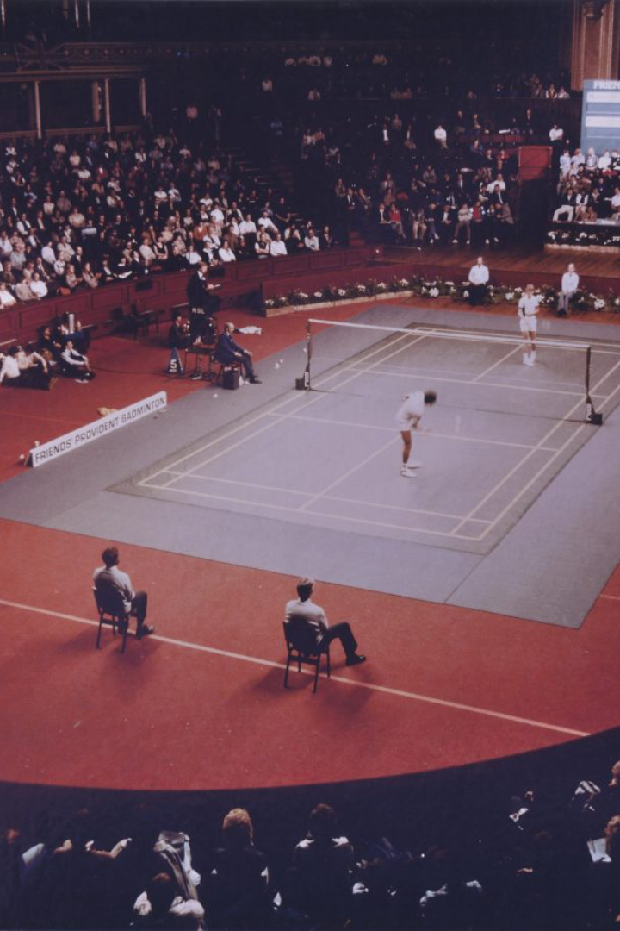
GEU BADMINTON TOURNAMENT
A showcase of talent and determination, the GEU Badminton Tournament is an exciting event that brings together some of the best shuttlers from around the world.

Slide 2
Introduction
Purpose of the tournament
History of the tournament
The tournament aims to promote and encourage the sport of Badminton among the youth, and to provide a platform for aspiring players to showcase their skills.
The tournament was first organised in 2012 and has since grown to become one of the most prestigious Badminton tournaments in the region.

Slide 3

Tournament Format
1
Singles category
A knock-out tournament where players advance by winning matches against competitors in a one-versus-one format.
2
Doubles category
A knock-out tournament where teams of two players advance by winning matches against other teams in a two-on-two format.
3
Mixed doubles category
A knock-out tournament where teams of one male and one female player advance by winning matches against other teams in a two-on-two format.

Slide 4
Preparation and Training for a Tournament
1
Physical Conditioning
2
Mental Preparation
3
Tactical Training
Practice mental techniques such as visualization and mindfulness to enhance focus, concentration, and resilience.
Work on specific game strategies, study opponents' playing styles, and hone your shot selection and court positioning.
Develop a regular training routine that includes cardio, strength, and flexibility exercises to optimize your performance.

Slide 5
Registration process
1
Eligibility criteria
2
How to register
3
Registration fees
The tournament is open to all students of GEU who are currently enrolled in a full-time programme.
Students can register for the tournament by filling out a form on the GEU website, or by registering at the tournament venue on the day of the event.
A nominal registration fee of 250 will be charged per participant.

Slide 6

Tournament schedule
1
Opening ceremony
The tournament will commence with an opening ceremony in the presence of dignitaries and players from the participating teams.
2
Match schedule
Match timings and schedules will be provided to the players before the start of the tournament.
3
Finals and closing ceremony
The tournament will conclude with the finals of all categories, followed by a prize distribution ceremony and closing remarks.

Slide 7

Benefits of Participating in a Badminton Tournament
Improves Skills
Participating in a tournament challenges you to enhance your badminton skills and refine your technique.
Competition & Motivation
Competing against skilled players pushes you to perform at your best and can ignite your motivation to excel.
Networking
Tournaments provide a great opportunity to meet fellow badminton enthusiasts, make new friends, and expand your network.

Slide 8

Strategies and Tactics for Winning in a Tournament
1
Analyzing Opponents
Study your opponents' strengths and weaknesses to devise effective strategies and exploit their vulnerabilities.
2
Mastering Footwork
Develop agile footwork techniques to move quickly and efficiently across the court, gaining a competitive advantage.
3
Variety in Shots
Use a combination of smashes, drops, clears, and deceptive shots to keep opponents guessing and to maintain control.

Slide 9

Prizes and awards
Categories for prizes
Prize distribution
Prizes will be given out to the winners and runners-up in each of the three categories, as well as the best male and female player of the tournament.
The prizes will be distributed during the closing ceremony of the tournament, along with certificates of participation for all players.

Slide 10
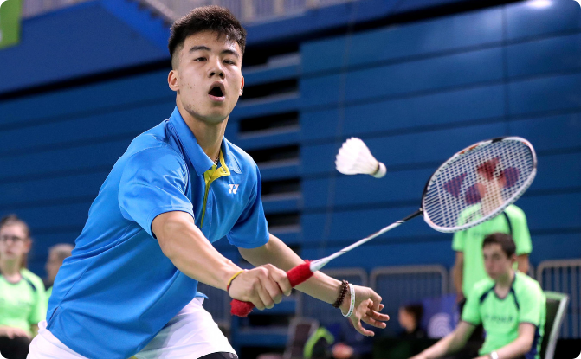
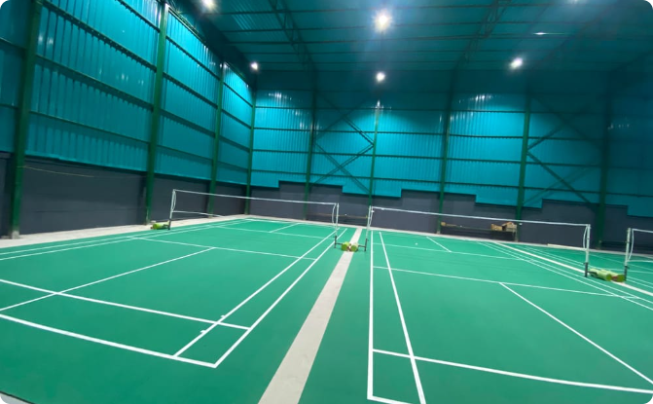
Conclusion
Thanking participants and sponsors
Announcement of the next tournament
We would like to thank all the players for their participation and our sponsors for their generous support.
We look forward to the next edition of the GEU Badminton Tournament, which promises to be even bigger and better than before.

Slide 11
CODE:-

Slide 12
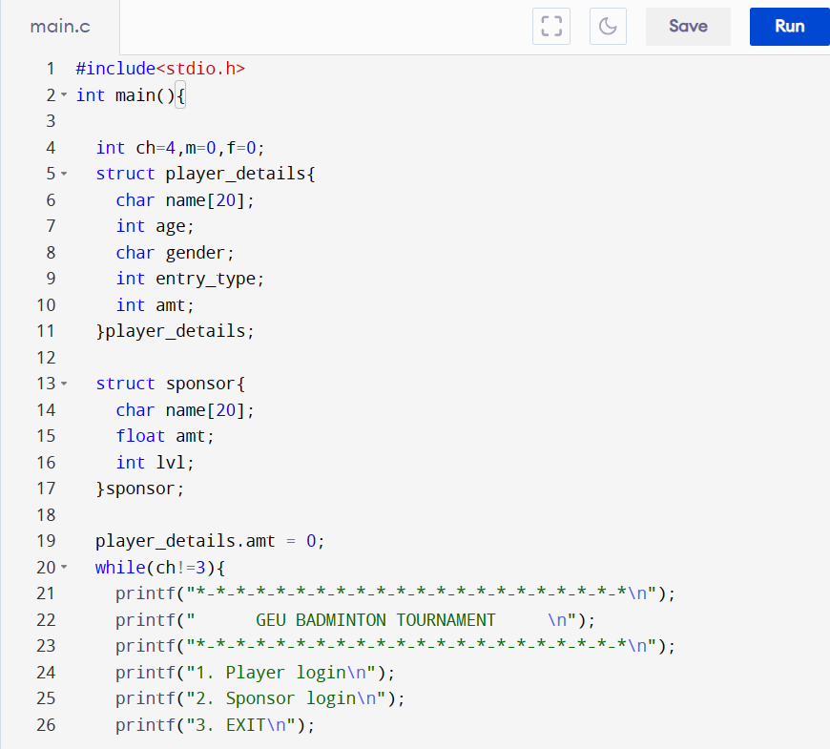
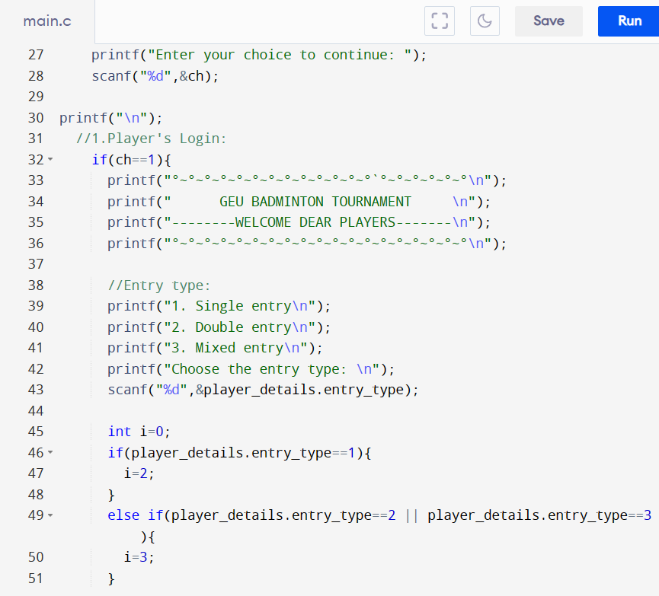

Slide 13
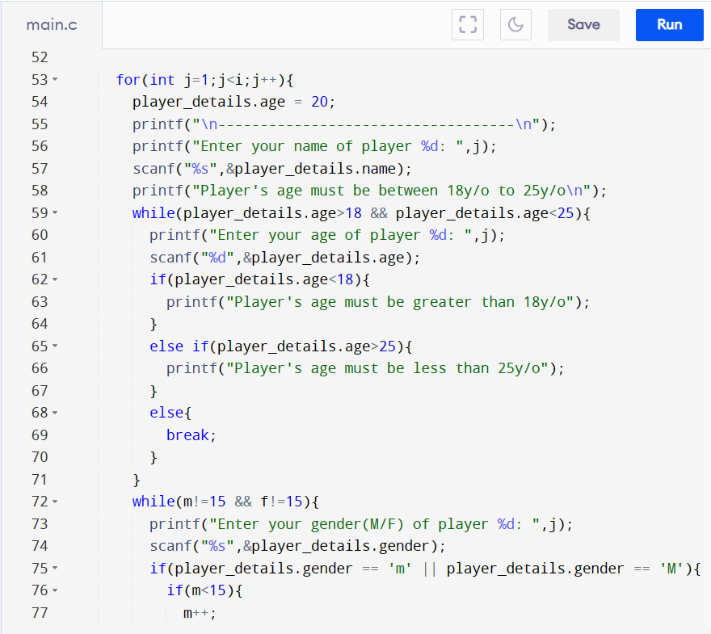
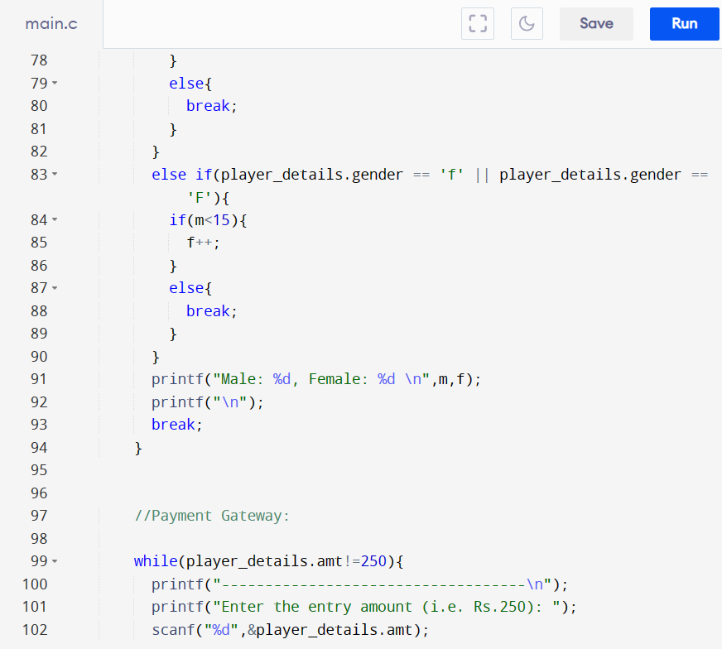

Slide 14
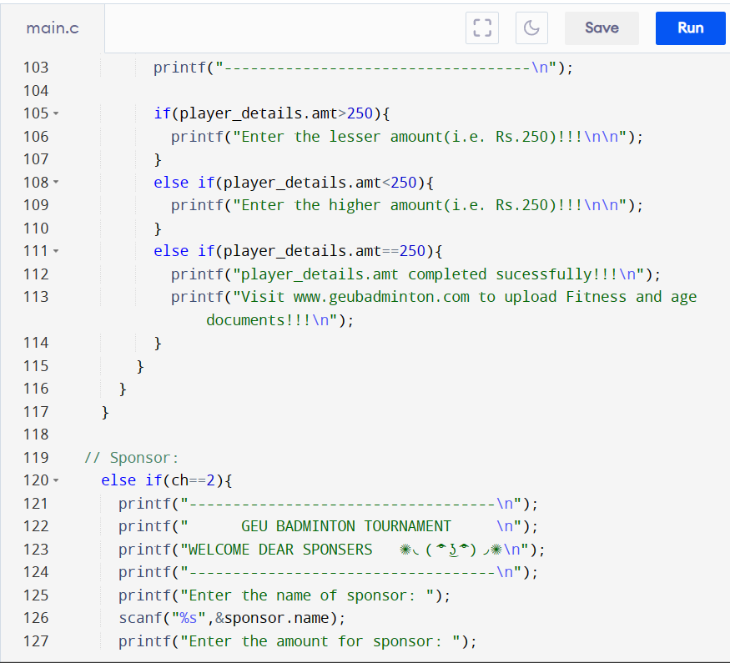
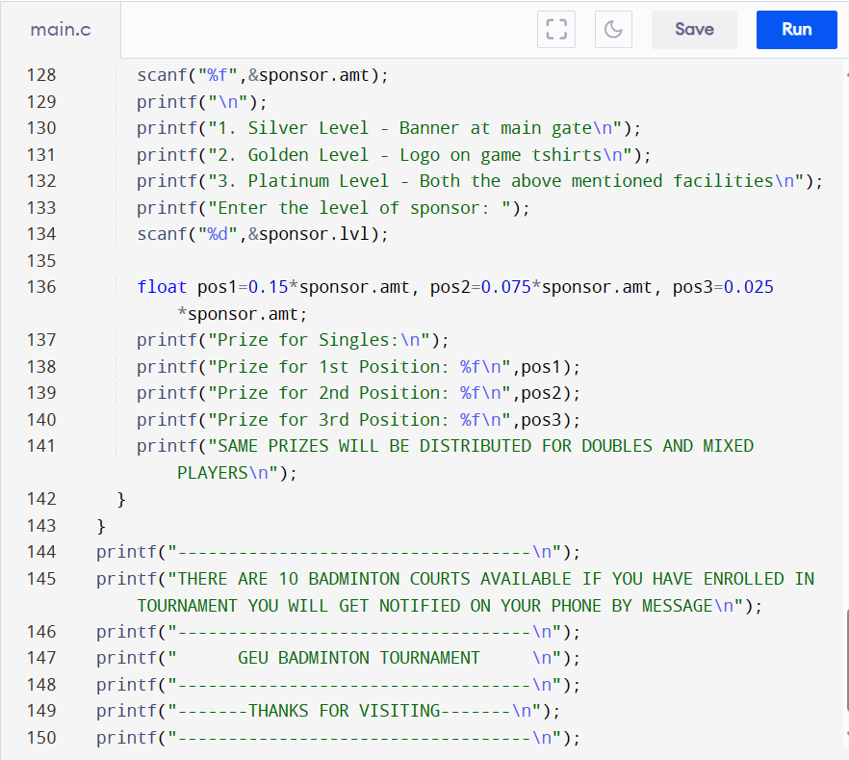

Slide 15
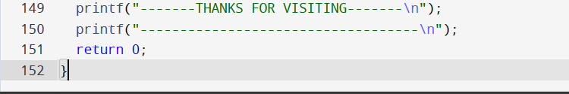

Slide 16
OUTPUTS:-

Slide 17
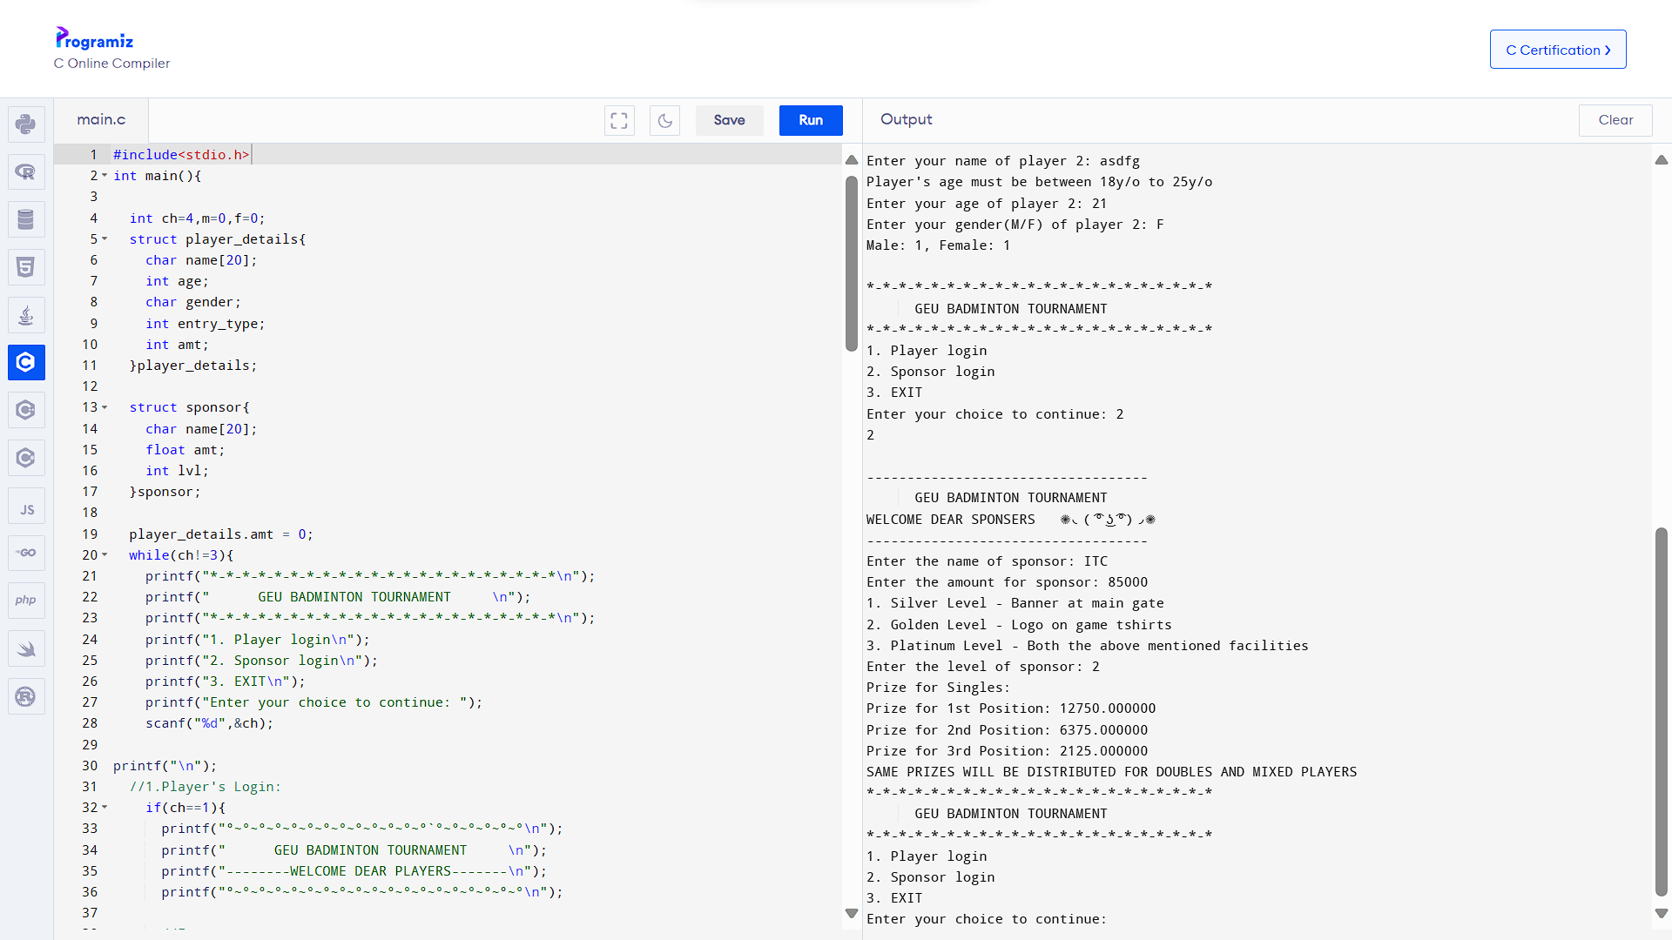

Slide 18
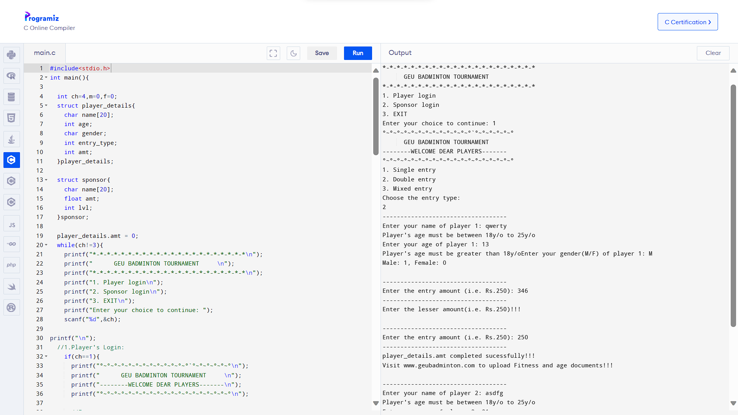

Slide 19
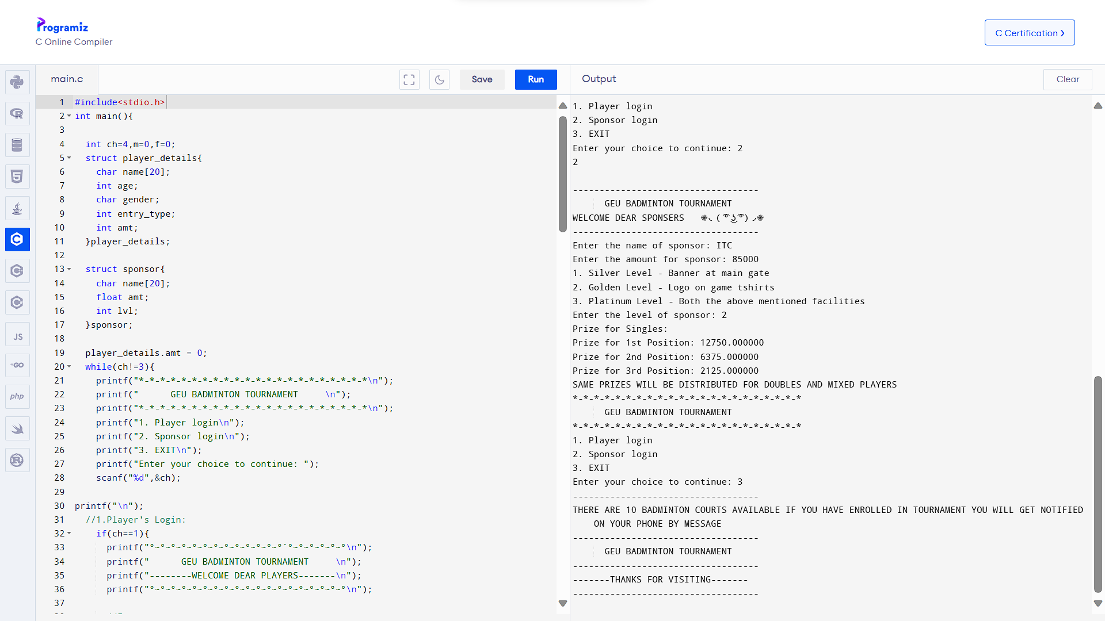

Slide 20

THANK YOU ALL FOR YOUR TIME AND ATTENTION DURING OUR PRESENTATION
OUR GROUP MEMBERS ARE:-
HIMANSHU MAWDI
SHARDUL RATURI
VAIDANSH THAPLIYAL

